Slide 1
Student Financial System
using
BLOCK CHAIN
5조
신승민 서상민
최효선 송동훈
Greg

Slide 2
INDEX
TOPIC
MODIFIED SYSTEM
ROLE
PROGRESS
PAPER

Slide 3
TOPIC

Slide 4
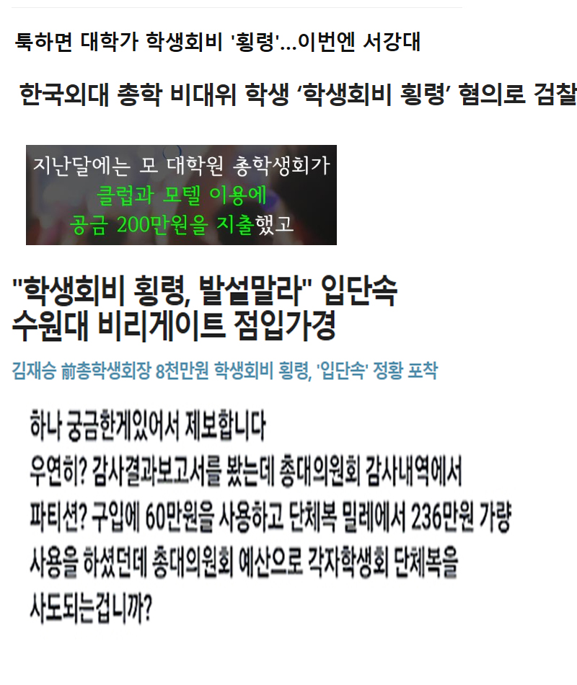

TOPIC
01
02
03
04
05

Slide 5
TOPIC
01
USING BLOCKCHAIN
02
03
04
05
Hard to Change
Public Trade Account Book

Slide 6
MODIFIED
SYSTEM

Slide 7

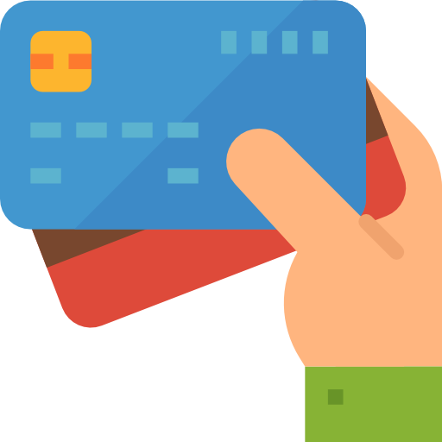

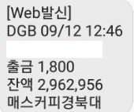



ORIGINAL SYSTEM
01
02
03
04
CENTRAL SERVER
DECENTRALIZED
SYSTEM
05
출금 1,800
잔액 2,962,956
18/09/12 22:10
매스커피경북대

Slide 8
MODIFIED SYSTEM
01
02
03
04
05

Slide 9
ROLE

Slide 10
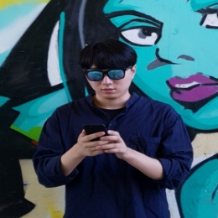
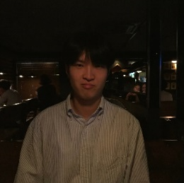

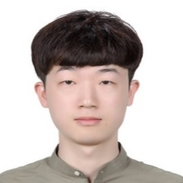
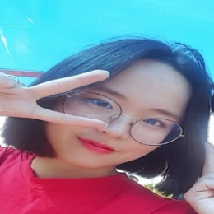
ROLE
01
02
03
04
05
SOLIDITY
WEB3.JS
HTML
Solidity
~~~~~~~~~~~~
~~~~~~~~~~~~
~~~~~~~~~~~~
Solidity+Web3
~~~~~~~~~~~~
~~~~~~~~~~~~
~~~~~~~~~~~~
Web3+Html
~~~~~~~~~~~~
~~~~~~~~~~~~
~~~~~~~~~~~~

Slide 11
PROGRESS

Slide 12
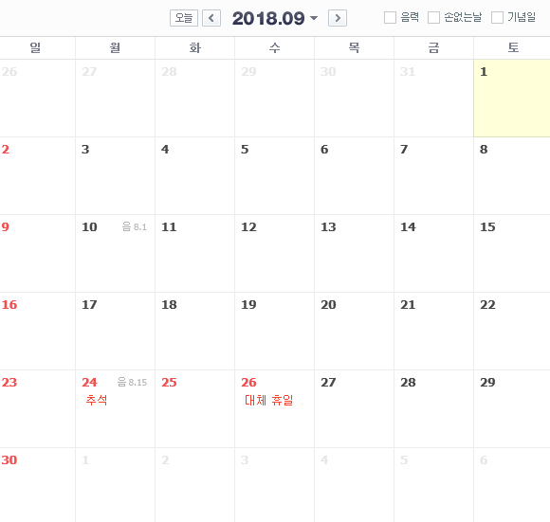


PROGRESS - Meeting
01
02
03
04
Mentor meeting
05
Change Topic & Total System design
Development Tool // Mentor meeting // Study
Study with mentor

Slide 13
PROGRESS - GIT
01
02
03
04
05

Slide 14
PROGRESS - GIT
01
02
03
04
05

Slide 15
PAPER

Slide 16
PAPER
01
02
03
04
05

Slide 17
Q & A

